Slide 1
PipedOutputStream und PipedInputStream
Notes:
https://www.straub.as/java/threads/

Slide 2
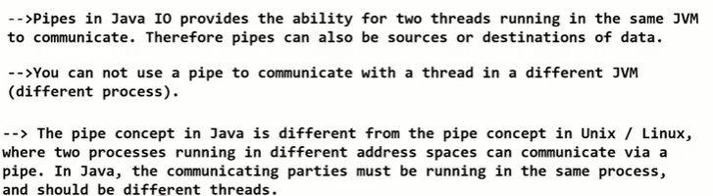
Pipes in JAVA
pipes to achieve thread communication.
Java has set of classes named PipedOutputStream & PipedInputStream to communicate between threads.
A piped I/O is based on the producer-consumer pattern, where the producer produces data and the consumer consumes the data.
Notes:
used for producer/consumer relationships
communication between producer and consumer (different threads) through a pipe
each pipe is manifested by a matched pair of stream pointers, a PipedInputStream and a PipedOutputStream, e.g.,

Slide 3
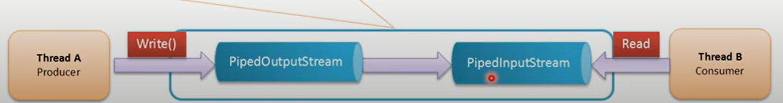
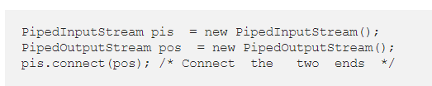

Two ways -Connect the pipes
Notes:
https://medium.com/@adisornbaimorakot/java-io-tutorial-java-pipe-42c5b148ada

Slide 4
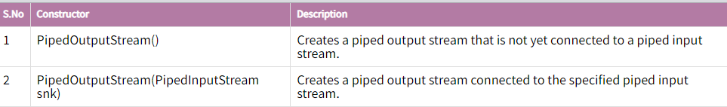
PipedOutputStream class:
A piped output stream can be connected to a piped input stream to create a communications pipe.
The piped output stream is the sending end of the pipe.
Typically, data is written to a PipedOutputStream object by one thread and data is read from the connected PipedInputStream by some other thread.

Slide 5
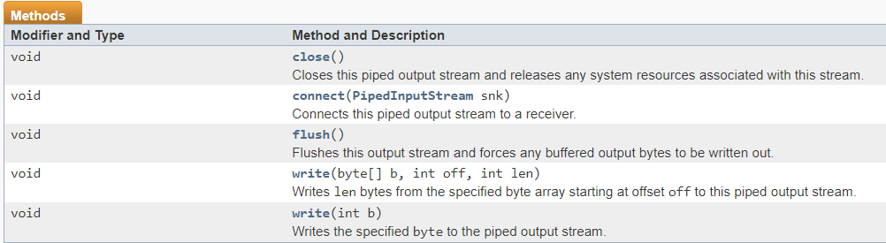
Pipedoutputstream methods

Slide 6
PipedInputStream class:
A piped input stream should be connected to a piped output stream.
the piped input stream then provides whatever data bytes are written to the piped output stream.
Typically, data is read from a PipedInputStream object by one thread and data is written to the corresponding PipedOutputStream by some other thread.

Slide 7
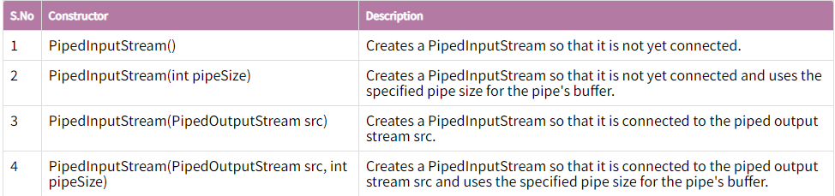
PipedInputStream methods

Slide 8
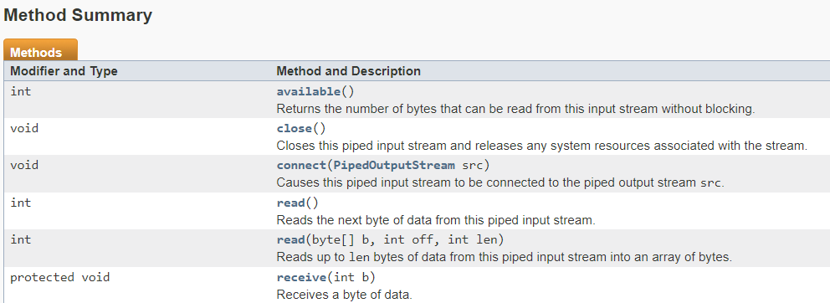
Methods of PipedInputStream

Slide 9
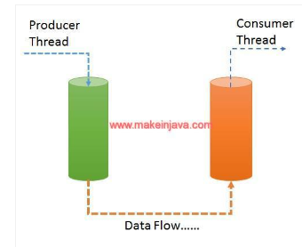
Producer consumer in java (PipedOutputStream/PipedInputStream)
Create producer & consumer threads.
Create PipedOutputStream & PipedInputStream objects.
Connect PipedOutputStream to PipedInputStream.
Producer thread writes data to PipedOutputStream.
Consumer thread will read data from PipedInputStream.

